Slide 1
Getting started with Naked Functions
Richard Pawson
28th February 2020

Slide 2
Pre-requisites
Visual Studio 2019
Community Edition is fine
.NET 5.0 and C# 9 installed
SQL Server
the LocalDb version included with VS is fine

Slide 3
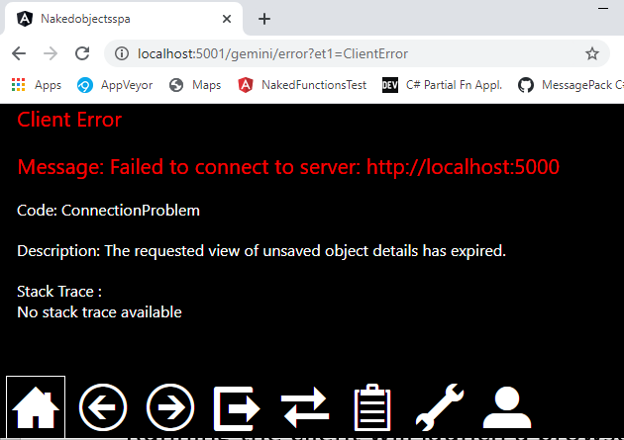
A Naked Functions application consists of two solutions: Server and Client
During development, it is best to run these two solutions in parallel, from two separate instances of Visual Studio
Download the ‘Template’ Client solution from: https://github.com/NakedObjectsGroup/NakedObjectsFramework/tree/master/Template/SPA%20Client
Running the client will launch a browser
We recommend using Chrome
After a short delay the client will state that it cannot access the server

Slide 4
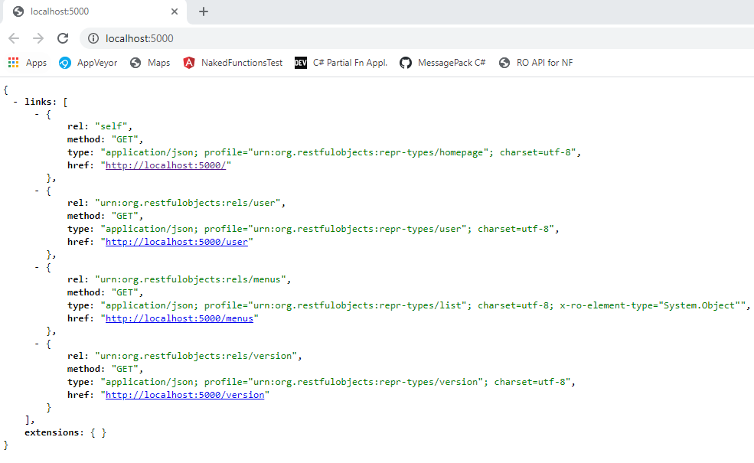
For the Server…
Download the ‘Template’ Server solution, from: https://github.com/NakedObjectsGroup/NakedObjectsFramework/tree/master/Template/Naked%20Functions%20Server
Running the server will launch its own browser showing the JSON Home representation of the RESTful API:
Shown here in Chrome with the JSON formatted by JSONView
But there is no need to be able to read or even view the JSON directly.

Slide 5

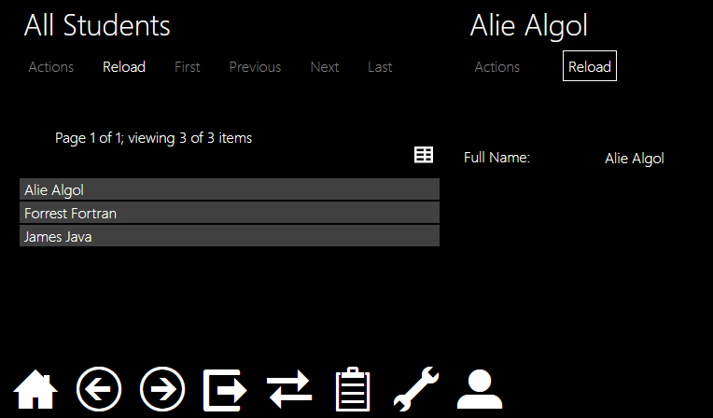
With the Server running, click Home ( ) on the Client
Then open the Students menu, click on All Students, then right-click on one of the returned list…

Slide 6
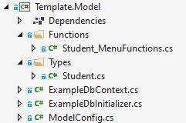
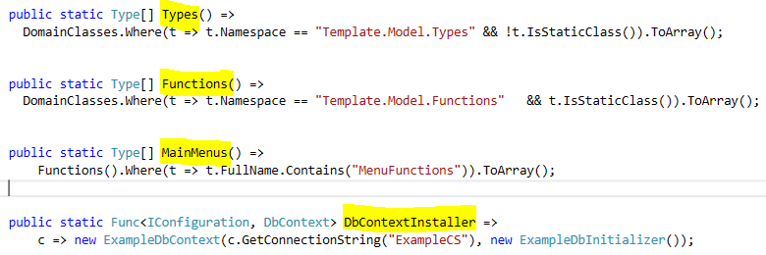
Explore the classes in the Model project:
1. Static class defining standalone functions that make up the Students menu
2. Record defining the Student type
4. ModelConfig is the mechanism by which the Server project finds out about the Types and Functions in the model it needs to work with. You don’t have to do it this way, but it is very convenient. See expanded version below:
3. Standard Entity Framework classes to manage persistence
5. Returns a list of domain types, using the convention of all records or enums found in Template.Model.Types. (You may edit this to suit).
6. Returns a list of static types defining all domain functions (both main-menu functions and object-contributed functions), using convention of all static types found in namespace Template.Model.Types
7. Returns a list of static types defining main menu functions: using convention of any static type where name contains ‘MenuFunctions’
8. Returns a function that, when invoked, will install the DbContext. Note that the connection string is defined in the Server project’s appsettings.json as normal.

Slide 7
Things to try
(Read The Naked Functions programming model presentation first)
Adding new properties to the Student type
DateOfBirth, Address, or splitting the FullName into FirstName and LastName
Use [MemberOrder] to control ordering, [Mask("d")] to format the DateTime property nicely
Adding or modifying a menu function, to find students using new properties
Creating a new Student_Functions static type, with static functions taking this Student s as the first parameter
Use this pattern to allow properties of a student to be edited, for example

Slide 8
Create a new type e.g. Subject, remembering:
To work with Entity framework, all records need an Id property
All properties must be marked virtual
Needed by Entity Framework to permit ‘lazy loading’ of references
Record properties should have {get; init;} accessors
Collections must return ICollection<T> and should be initialized
Override the ToString method to define a display title
Add these two lines of boilerplate code:
public override int GetHashCode() => base.GetHashCode();
public virtual bool Equals([NewTypeName] other) => ReferenceEquals(this, other);
(Entity Framework currently needs these - to handle records correctly).

